Slide 1
Final Projects
Lesson 23.2

Slide 2
Class Objectives
By the end of today’s class you will be able to:
Import a pretrained CNN model.
Load an image from a file into a data array.
Apply preprocessing to the input data.
Use a pretrained model to make a prediction.

Slide 3
Activity: Explore CNN
In this activity, you will use pretrained models to build a high-level understanding of CNNs and your application.
15 Minutes
Notes:
👥 1.1 Partners Do: Explore CNN (15 min)

Slide 4
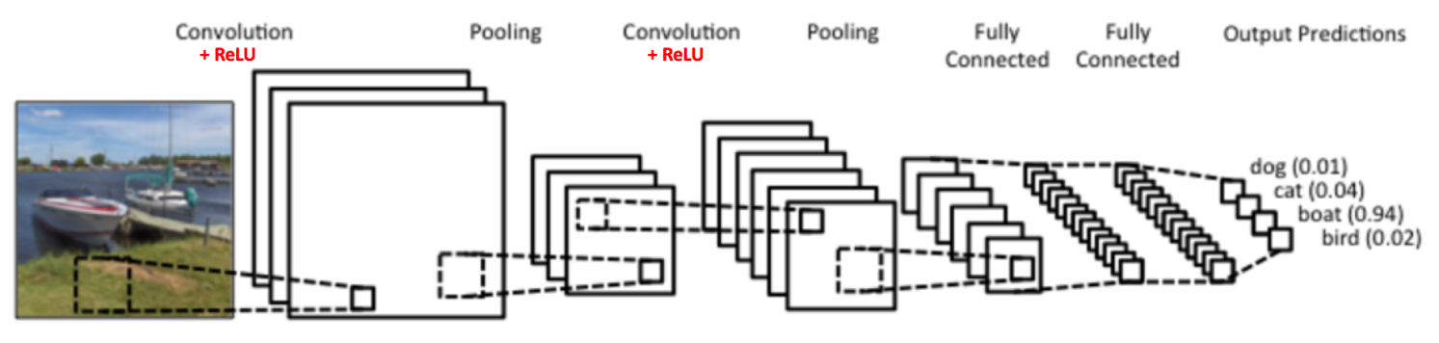
Activity: Explore CNN
Instructions | Work with a partner to answer the following questions: What is a convolutional neural network (CNN)? What is a CNN typically used for? What is the difference between a CNN and a deep neural network?

Slide 5
Notes:
📣 1.2 Instructor Do: Review Explore CNN (15 min)

Slide 6
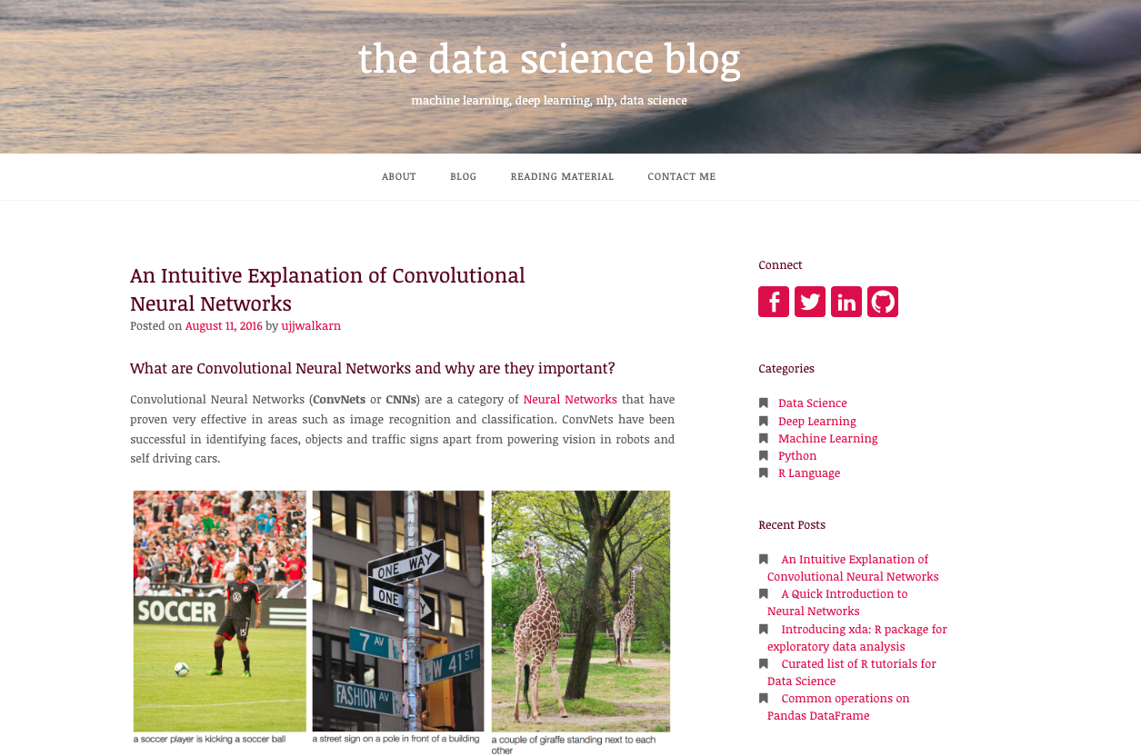
Activity: Explore CNN
The Data Science Blog has a nice high-level explanation of CNNs.
https://ujjwalkarn.me

Slide 8
Pretrained Models
Notes:
📣 1.3 Instructor Do: Pretrained Models (15 min)

Slide 10
Xception
20 Minutes
Notes:
✏️ 2.1 Students Do: Xception (20 min)

Slide 11
Activity: Xception
Instructions | Use the starter notebook Xception.ipynb for this activity.
 | Visit the Xception documentation to determine the image size and any other parameters needed to load and use the model.
 | Preprocess the test image by using the model’s preprocess_input function.
 | Use the trained model to predict the output label for the puppy image.
Bonus | Refactor your code into a reusable function that accepts an input image and returns a preprocessed image.
 | Test the code by preprocessing the image of a kitten and printing the predicted labels.

Slide 12
Notes:
⭐ 2.2 Review: Xception (0:10)

Slide 15
Project Work
90 Minutes
Notes:
✏️ 3.1 Students Do: Project Work (90 min)

Slide 16


Project Work: AWS
Remember to closely monitor any AWS resources that you choose to use.
It’s crucial that you clean up and stop, or shut down any AWS resources to avoid accruing additional costs.
Double-check your billing costs.

Slide 17
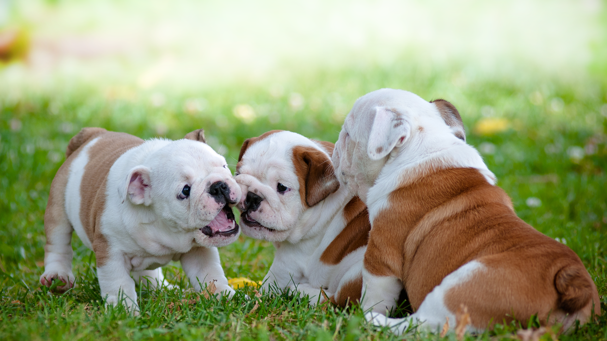
Time to divide into teams!
Notes:
shutterstock_81648802

